Slide 1
pRINT TO DIGITAL
THINKING DIFFERENTLY ABOUT THE SAME STORY

Slide 2
Takeaways:
Stories must be told differently online to match the reader’s experience
Current trends include emphasis on mobility, integration with social media and multimedia storytelling
Specific challenges can be addressed

Slide 3
Case study:
Malone University Aviso
Student media as journalism laboratory

Slide 4
Year one:
All in
We made some bad assumptions

Slide 6
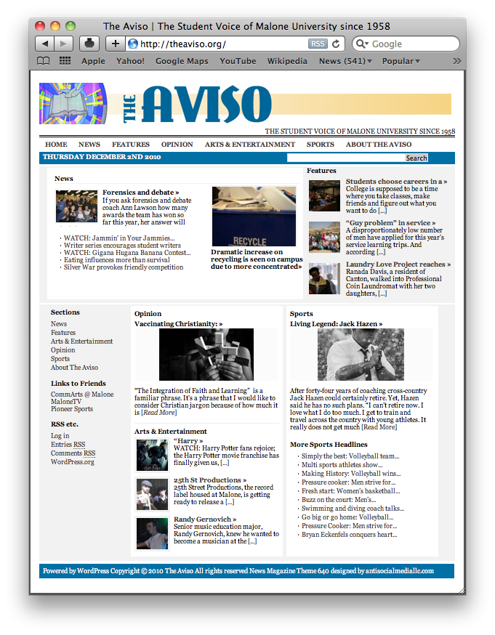

Slide 7
Key findings
We tried to transition slowly from print to digital, but we were far too conservative in provided our approach
Good news: It was an important baseline for evaluating future changes

Slide 8
Year 2: truly a web publication
Major restructure, with surprising results

Slide 10
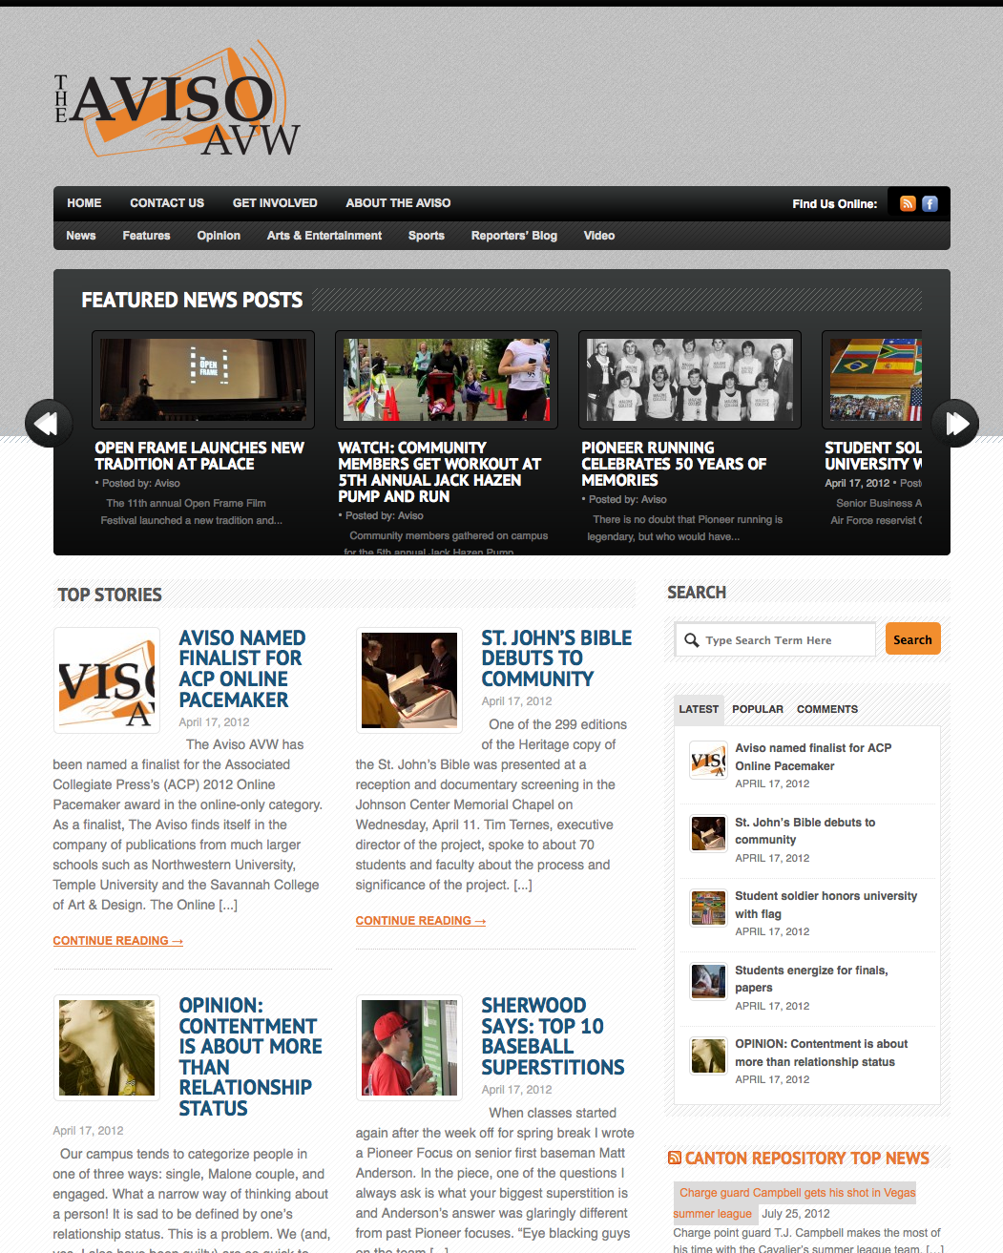

Slide 11
Key findings
New emphasis on visual storytelling, integrated into the editorial process from concept to publication

Slide 12
Key findings
New emphasis on visual storytelling, integrated into the editorial process from concept to publication
Added video for both storytelling and entertainment (features)

Slide 13
Key findings
New emphasis on visual storytelling, integrated into the editorial process from concept to publication
Added video for both storytelling and entertainment (features)
Emphasized storytelling that included both text and video (and just audio)

Slide 14
Key findings
New emphasis on visual storytelling, integrated into the editorial process from concept to publication
Added video for both storytelling and entertainment (features)
Emphasized storytelling that included both text and video (and just audio)
Added photos of writers to increase personalization

Slide 15
Key findings
New emphasis on visual storytelling, integrated into the editorial process from concept to publication
Added video for both storytelling and entertainment (features)
Emphasized storytelling that included both text and video (and just audio)
Added photos of writers to increase personalization
Began working with social media (specifically Facebook) both from the publication and individual writers

Slide 16
Year 3:
Tweaking and marketing
Strategic refinements,
with more dramatic results

Slide 17
Key findings
Changed publication cycle to spread out release of stories

Slide 18
Key findings
Changed publication cycle to spread out release of stories
Use social media even more, timed usage to when students were likely to be online

Slide 19
Year 4: the experiment ends
But we knew where we needed to go next

Slide 20
Key findings
We desperately needed a design update to a dynamic, mobile-friendly design
Even better, we really wanted an iOS app
Needed to extend our social media to other platforms, especially Twitter, Instagram, Pinterest
  Today that would be Instagram, TikTok and maybe Discord

Slide 21
A couple failures
QR codes had no traction at all
RSS died (and this was sad)
  But it underlies Notifications, so you can still use it

Slide 22
more current trendS
Digital media are no longer the exotic media—they’re the “normal” media

Slide 23
more current trendS
Digital media are no longer the exotic media—they’re the “normal” media
Stories increasingly start on social media and migrate to webpages

Slide 24
more current trendS
Digital media are no longer the exotic media—they’re the “normal” media
Stories increasingly start on social media and migrate to webpages
Story structures are becoming more fragmented as smaller chunks work better on small screens (and with short attention)
  More use of subheads
  More use of lists and bullets

Slide 25
more current trendS
Younger people especially read less than ever (in some ways), but they listen constantly
  Podcasts continue to increase in popularity
  Audio versions of stories alongside text versions can be helpful

Slide 26
Questions? Your Ideas?

